Slide 1


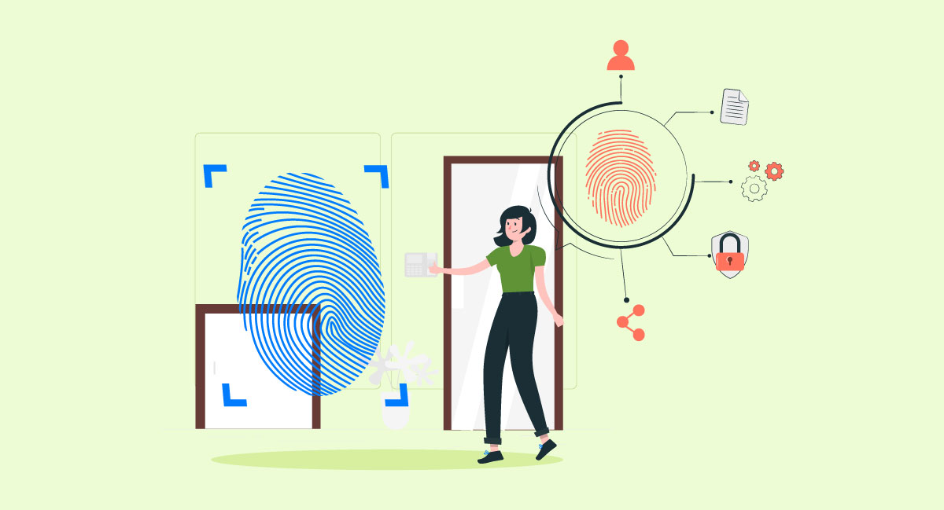




‘PiTrack’ Raspberry Pi-Powered Smart Attendance System
Members:
Md Aquib: 12215525
Minakshi Sharma: 12215884
Md Aiyaz: 12215953
Vivek Kumar Gupta: 12215379

Slide 2

Introduction
Our project utilizes IoT technologies like ESP32, Raspberry Pi, LCD, buzzer, and LEDs.
Aims to automate attendance tracking, enhance efficiency, and accountability.
Enhances security by employing encrypted communication protocols.
Traditional attendance tracking methods lack efficiency and accuracy.
Designed to be cost-effective, with minimal maintenance requirements.
Promotes sustainability by reducing paper usage and energy consumption.

Slide 3
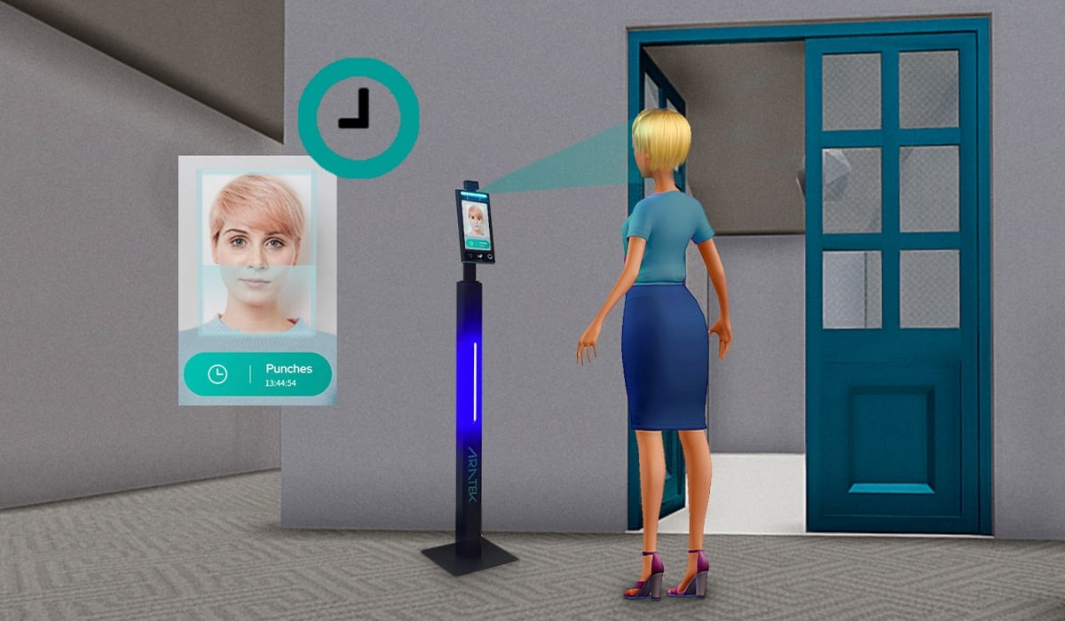
Applications
Schools and Offices: It is a perfect fit for these environments where attendance tracking is crucial.
Public Building: Places like libraries, museums, or government buildings.
Hospitals and Clinics: Especially in areas with high infection risks, this system could help with quick screening and monitoring of patients and staff.
Events and Conferences: Large gatherings can pose health risks. This system could be used for entry control and initial health screening.
Manufacturing Facilities: Factories with shift changes or frequent personnel movement could benefit from streamlined attendance tracking and health monitoring.

Slide 4
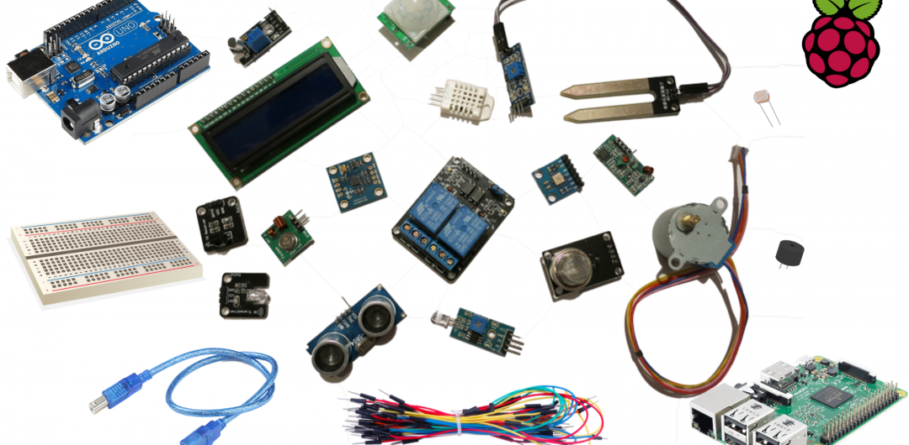
Components
Raspberry PI
ESP32 Microcontroller
RFID
16x2 Line LCD Display,
I2C SP Serial Interface Module Port For LCD display
5v Active buzzer

Slide 5
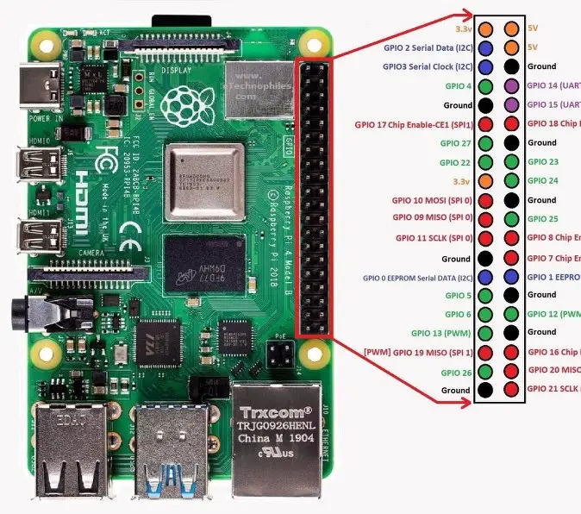
Raspberry PI

Slide 6
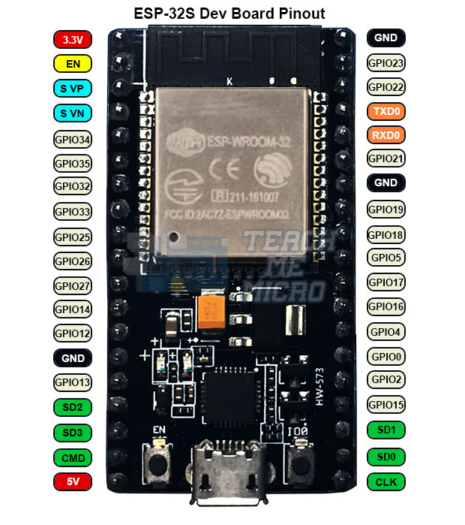
ESP32

Slide 7
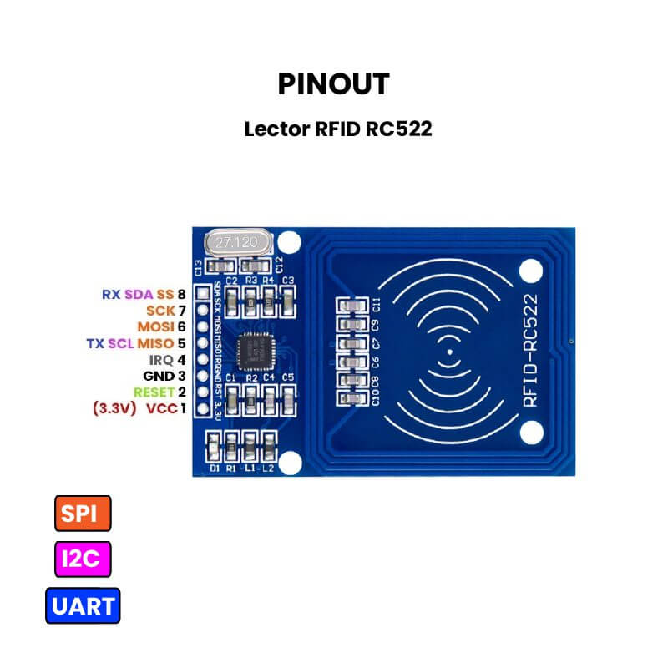
RFID

Slide 8
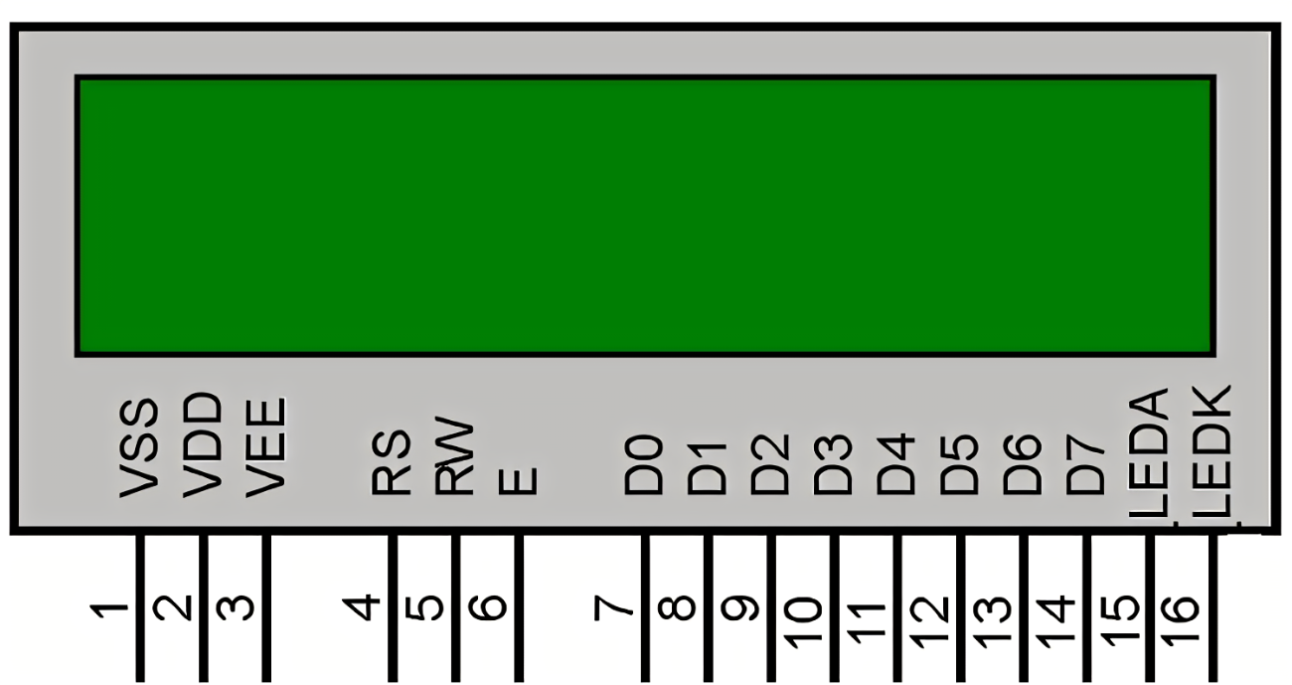
LCD 16x2

Slide 9
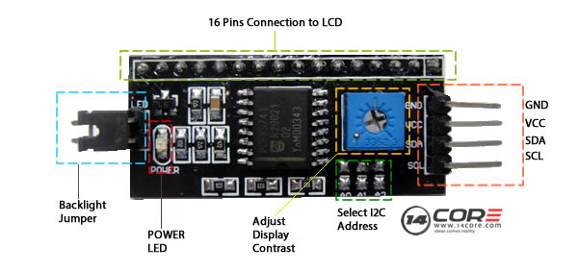
I2C

Slide 10
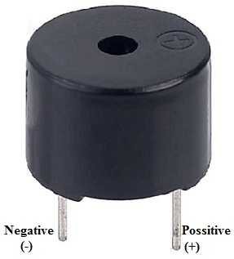
Buzzer

Slide 11
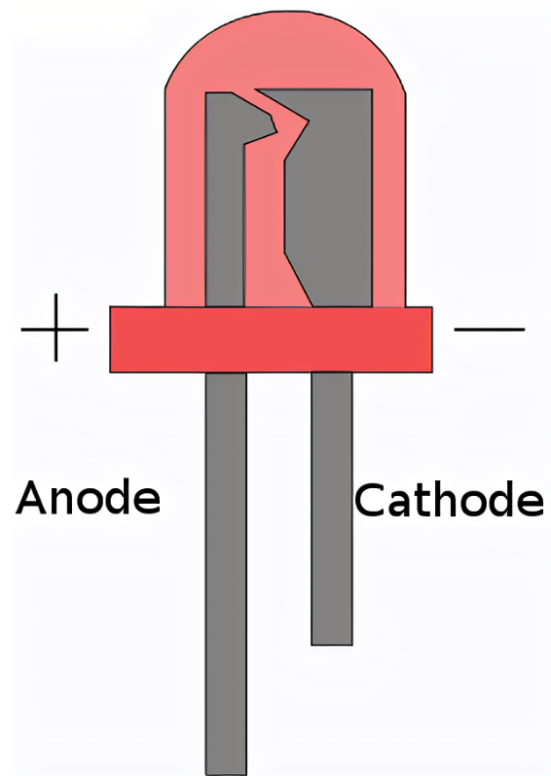
LED

Slide 12
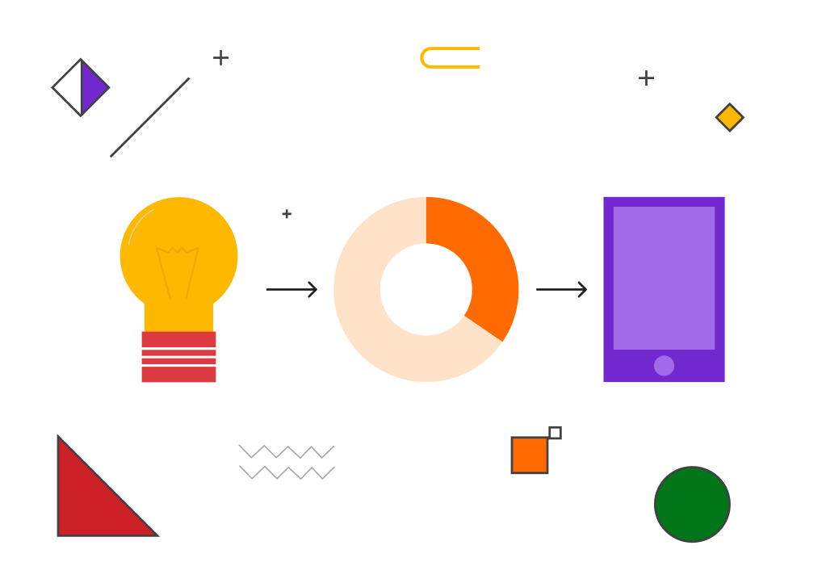
Design Methodology
System Requirements and Design
Hardware Selection
Software Development
Integration and Testing
Deployment and Maintenance

Slide 13
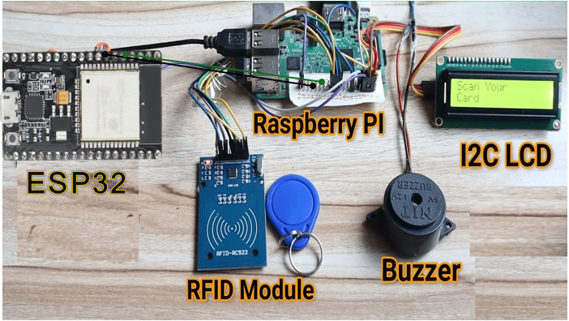
Circuit Diagram

Slide 14
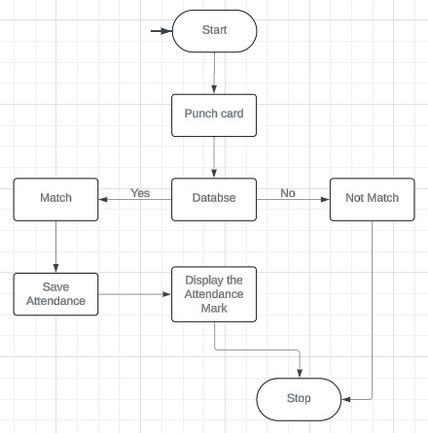
Flow Chart

Slide 15
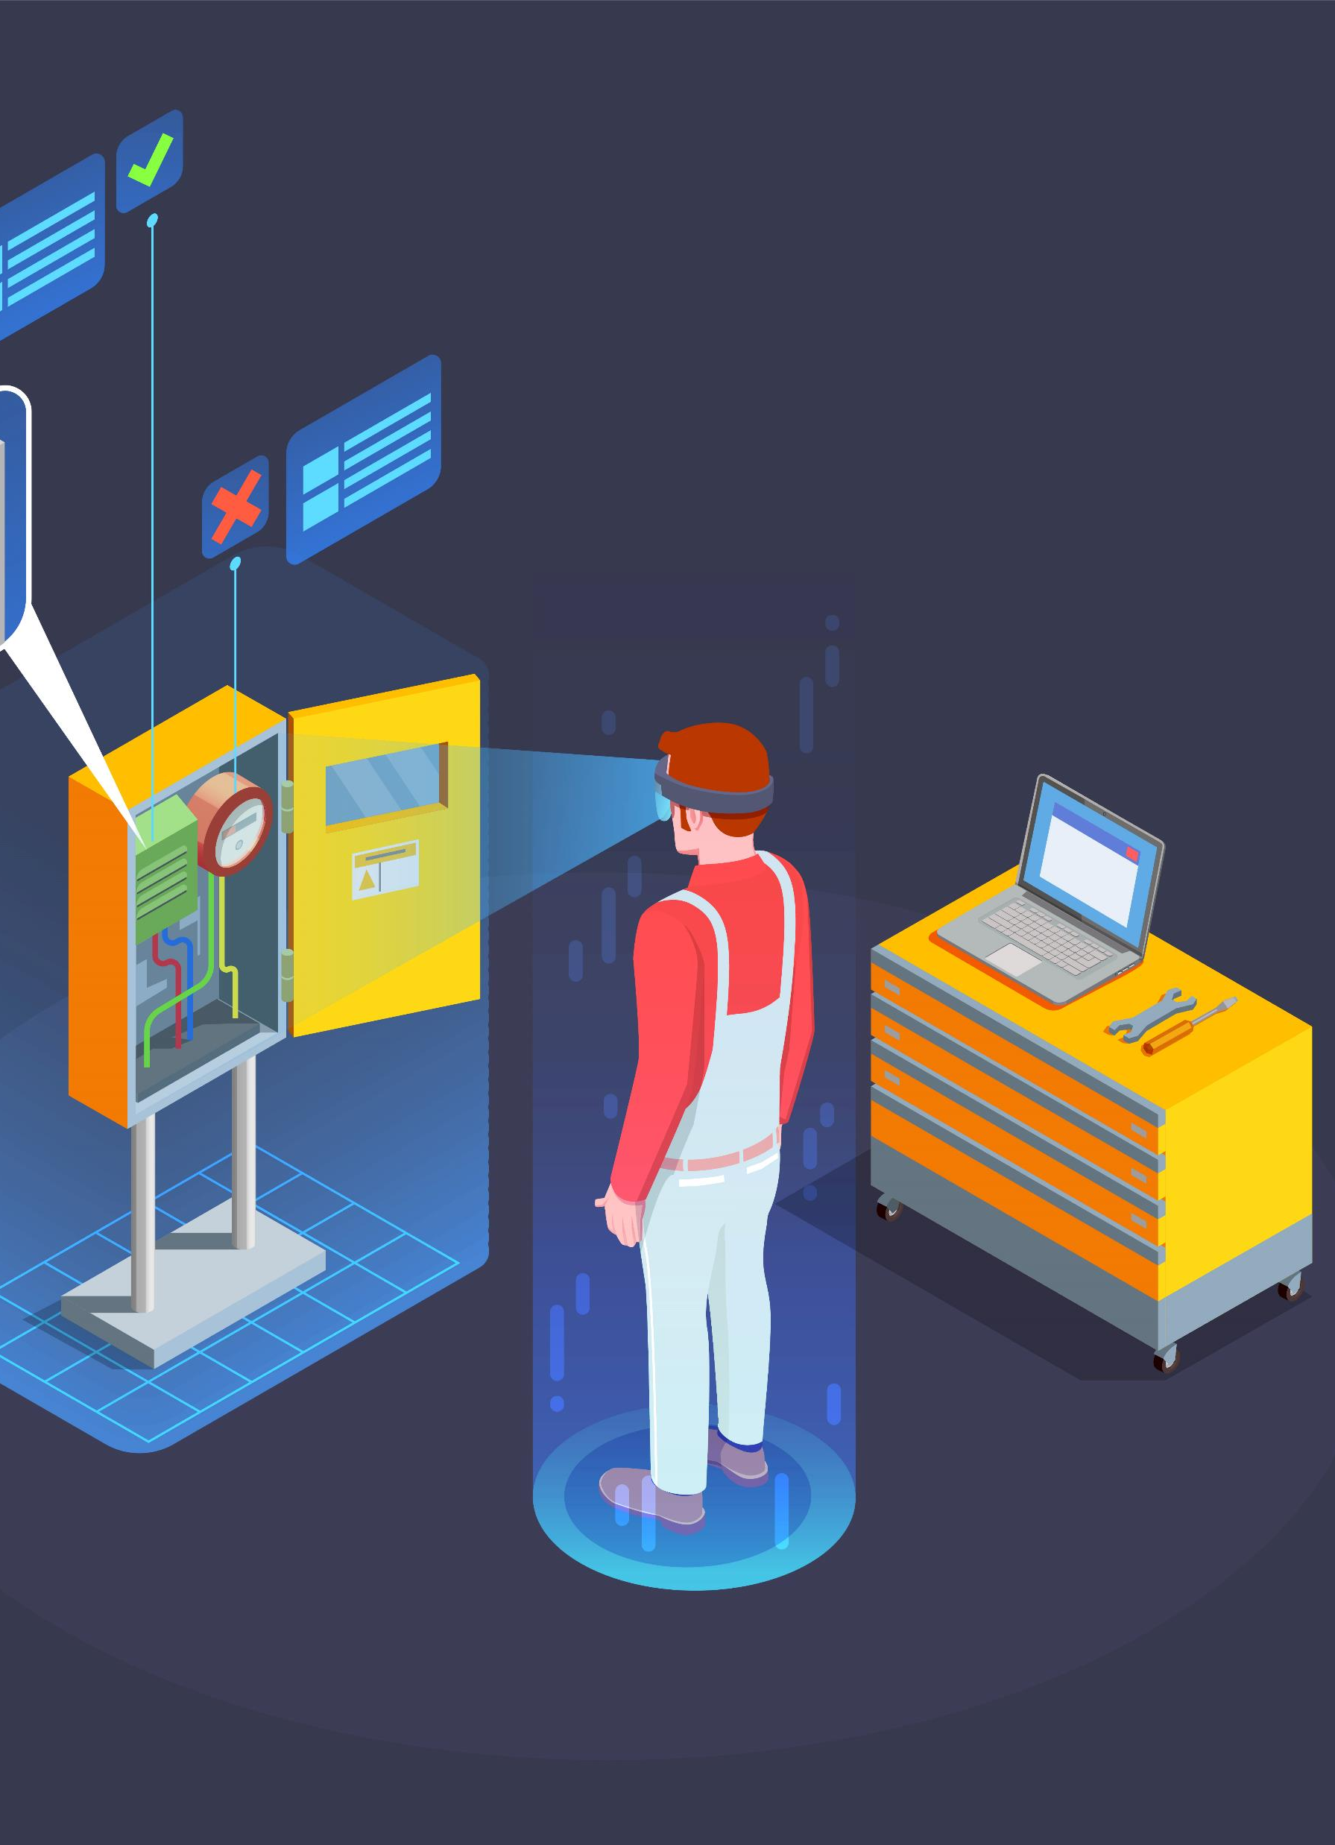
5 Reasons To Use Smart Attendance Machine
Get rid of paper-based monitoring
Saves time
Saves Money
Most Accurate tracking solution
Better Security

Slide 16

Conclusion
Increased Efficiency: This project successfully automates attendance recording, eliminating the need for manual processes and saving time.
Wide Applications: The system is suitable for various environments like schools, offices, and public buildings, offering a versatile solution.
Benefits include: Real-time tracking, accessibility, customization, and scalability.
Future Potential: Further development could involve integration with existing attendance systems or adding features like mask detection for even greater effectiveness.

Slide 17

Thank You

